Slide 1
NAME: AYESHA NAWAZ KHAN
TOPIC: GRAPHIC PROCESSING
UNIT

Slide 2
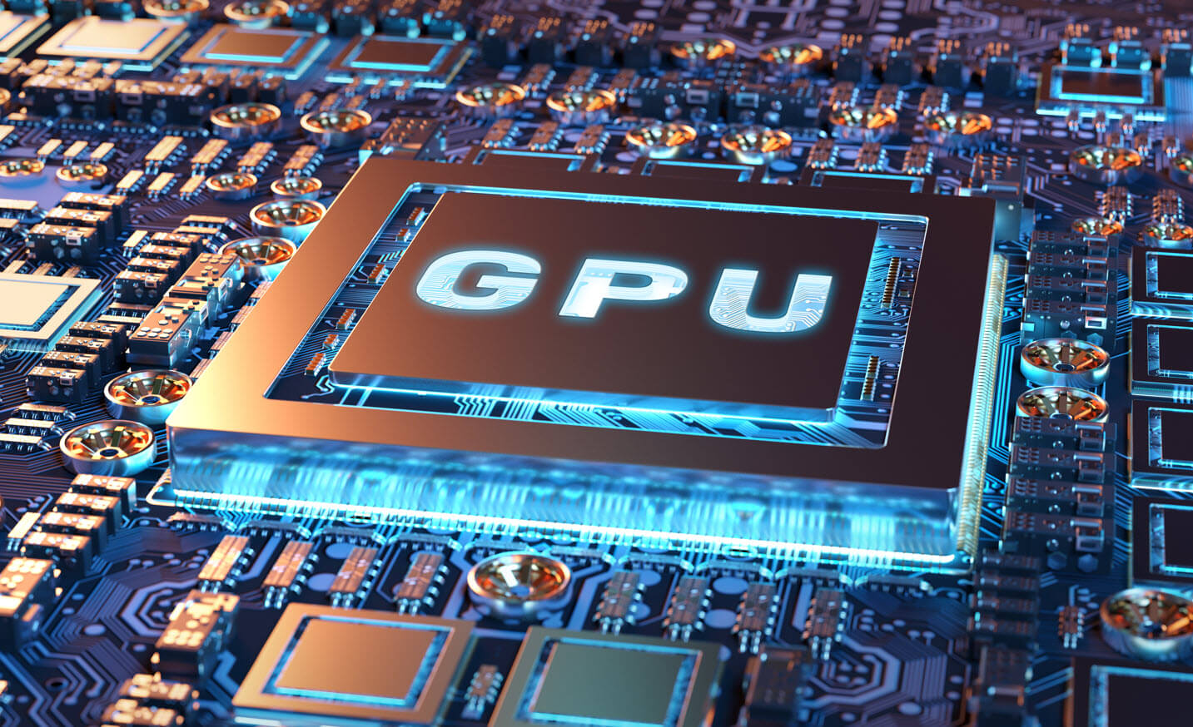
GRAPHIC PROCESSING UNIT

Slide 3
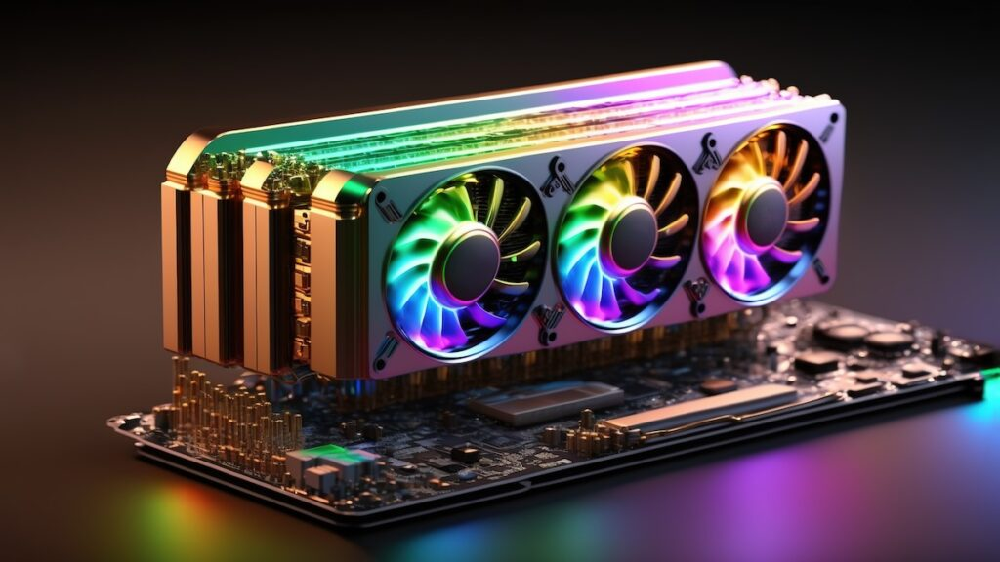
FULL FORM OF GPU
GPU Stands for Graphic Processing Unit

Slide 4

What are Graphics?
How are they even processed?
Graphics?

Slide 5
Graphics is any visual that is displayed on a screen.
Processing involves following steps:
Input data
Processing (using billions of transistors)
Shading
Rendering (converting those dots into pixels)

Slide 6
History of GPUs
Why GPU was needed?
Who launched first ever GPU?

Slide 7
Computer Engineers realized that a single CPU cannot perform all the functions. It could not handle alone all the massive amount of graphical computations.
The first GPU named GeForce 256 made by a company NVIDIA in 1999.

Slide 8
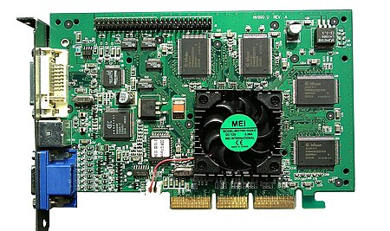
GeForce 256

Slide 9
How GPUs Work?

Slide 10
GPUs are made of small processing units also known as cores.
While a CPU (Central Processing Unit) is good at handling one task at a time, a GPU can do many things simultaneously.
The game or app creates 3D objects, but your screen is 2D.
A GPU is like a multi-tasking engine that can process thousands of tasks at the same time.

Slide 11
CAN A COMPUTER WORK WITHOUT A CPU AND GPU?

Slide 12
Applications of GPUs
Gaming: Fast rendering of detailed game environments.
AI & Machine Learning: Speed up complex data processing.
Video Editing: Real-time video rendering.
Cryptocurrency Mining: Efficient hashing for crypto transactions.

Slide 13
Types of GPUs
Integrated: Built into the CPU, for less intensive tasks.
Dedicated: Standalone, for high-performance computing needs.

Slide 14
Conclusion
GPUs are critical for high-performance tasks in gaming, AI, and more.
Their future involves breakthroughs in processing speed and efficiency.

Slide 15
THANK YOU

